Slide 1
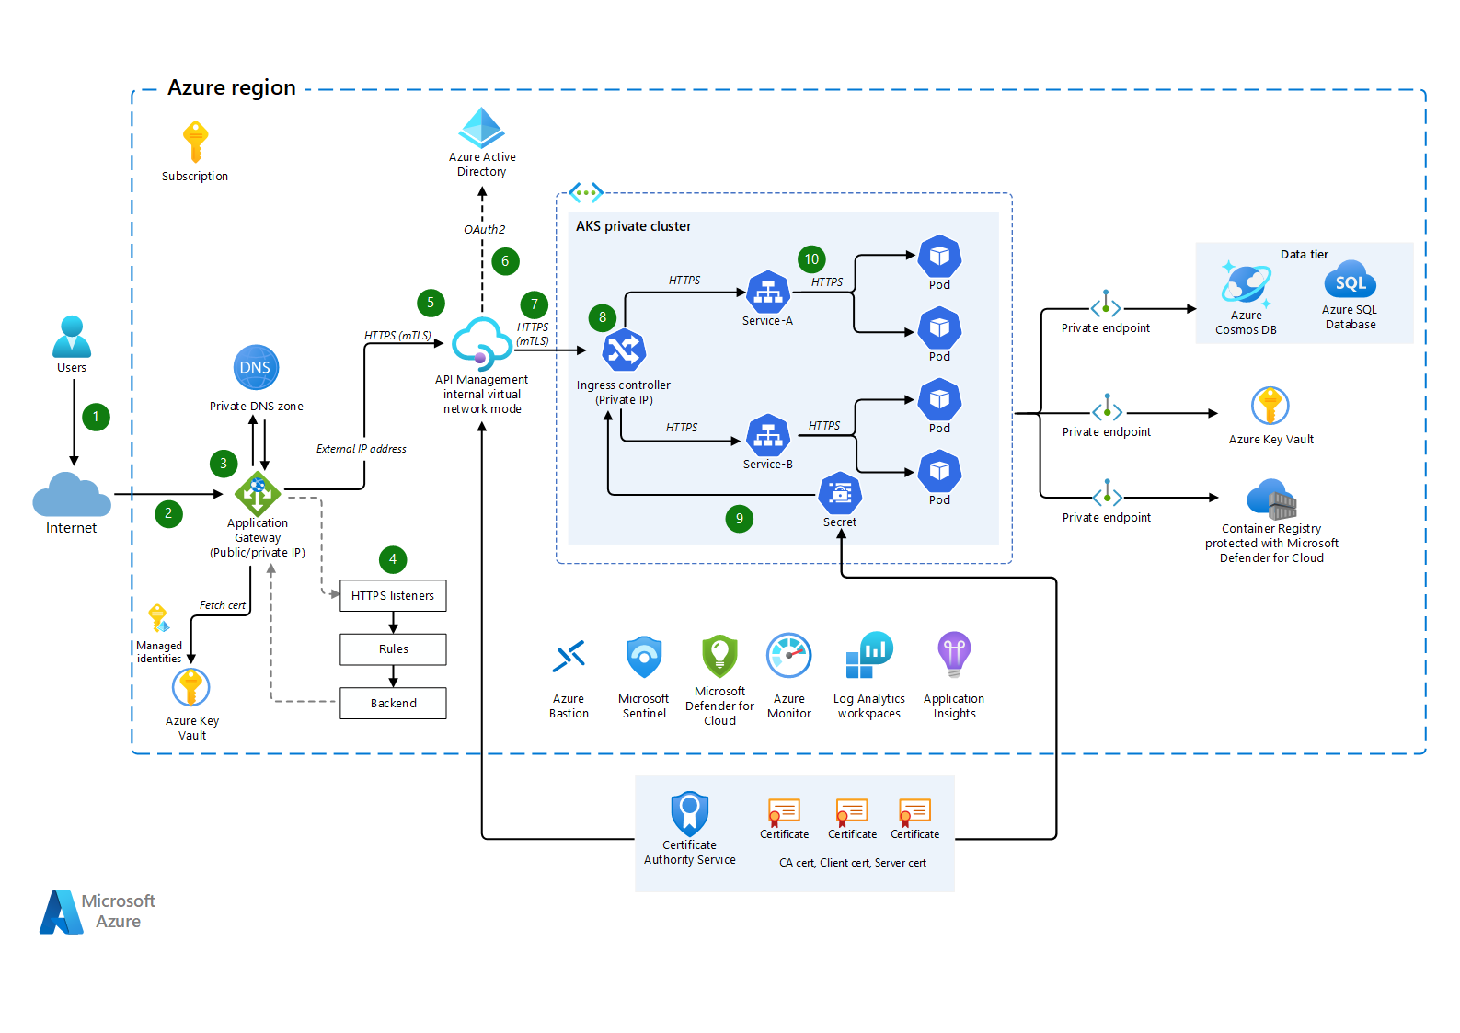

Slide 2
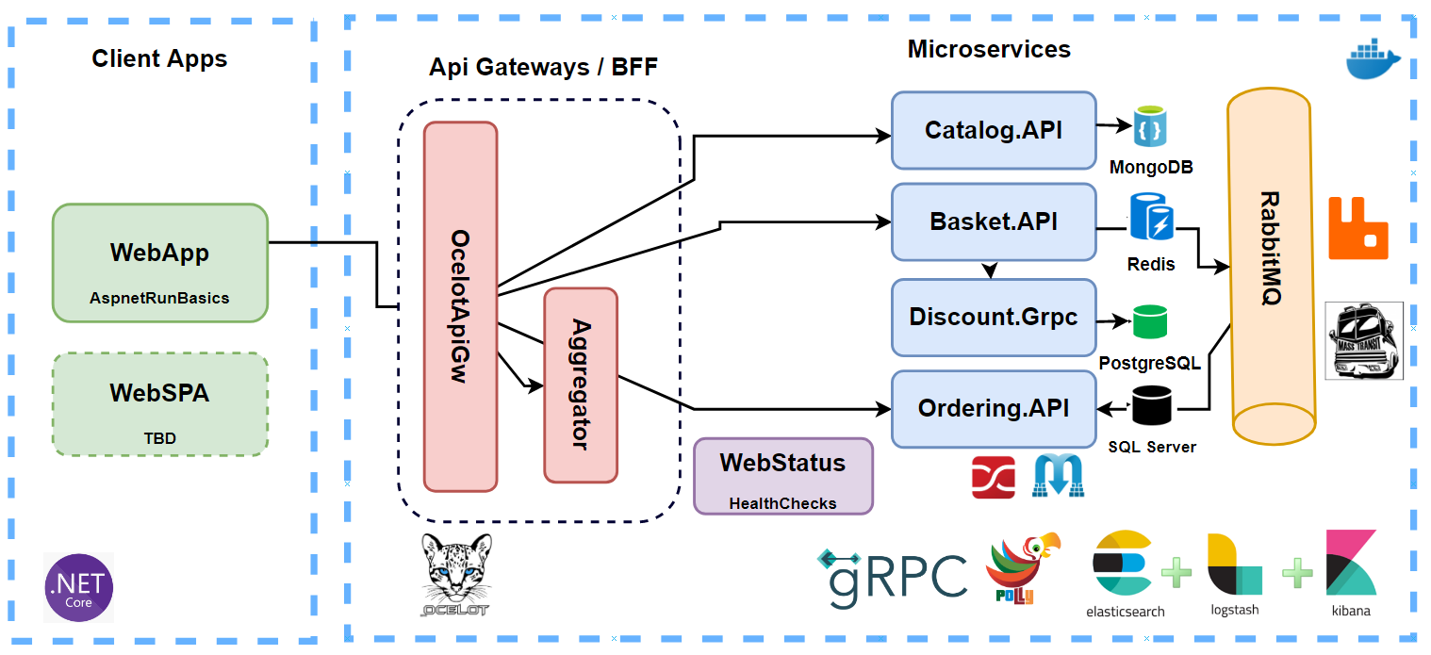

Slide 3
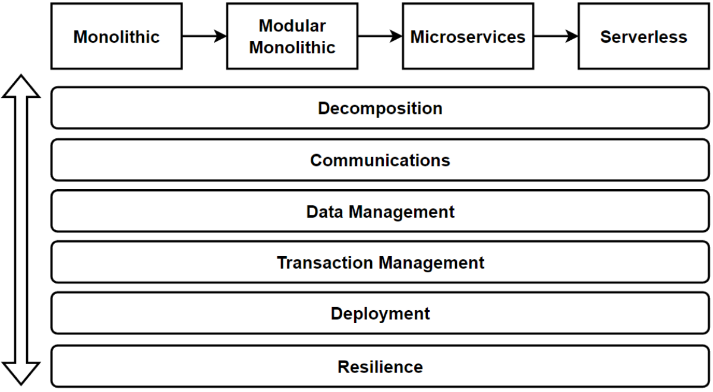
Microservices Decomposition — Breaking Down Microservices
Microservices Communications (Sync / Async Message-Based Communication, API Gws)
Microservices Data Management (Databases / Query / Commands)
Microservices Transaction Management
Microservices Distributed Caching
Microservices Deployments with Containers and Orchestrators
Microservices Resilience with Distributed Logging, Tracing and Health
Microservices Testing; Contract Testing, Integration Testing, E2E Test
Microservices Security; Authentication and Authorization

Slide 4
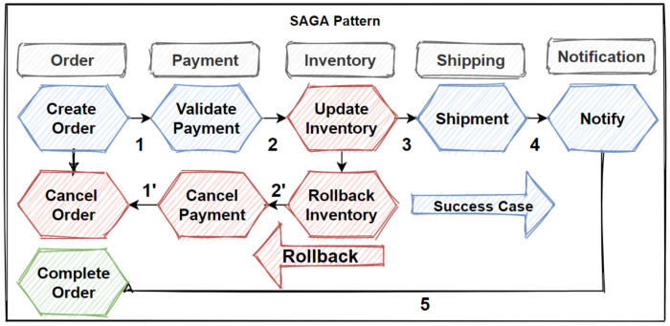

Slide 5
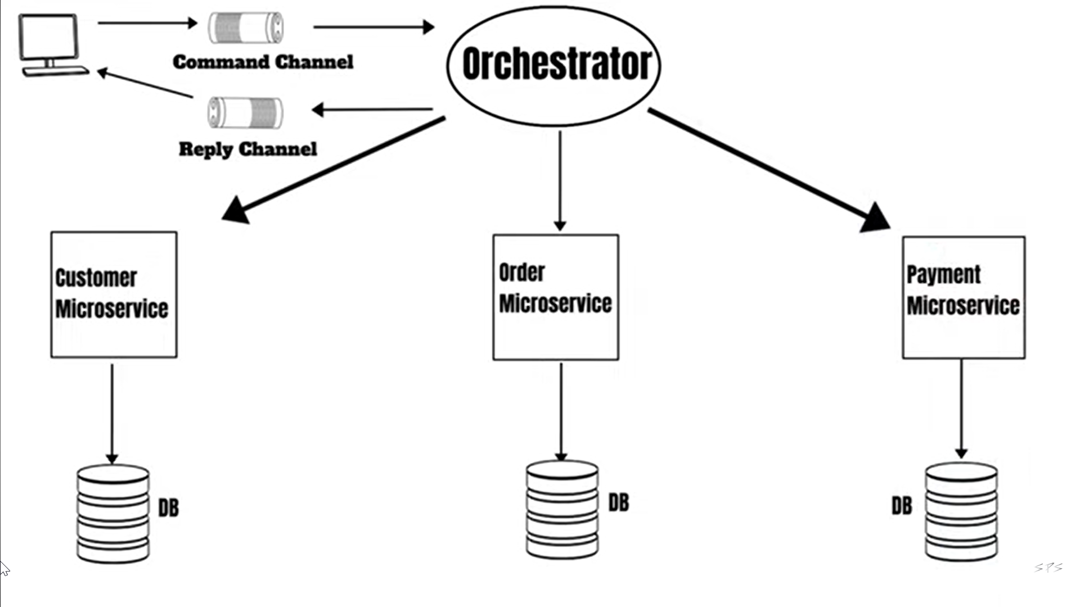

Slide 6
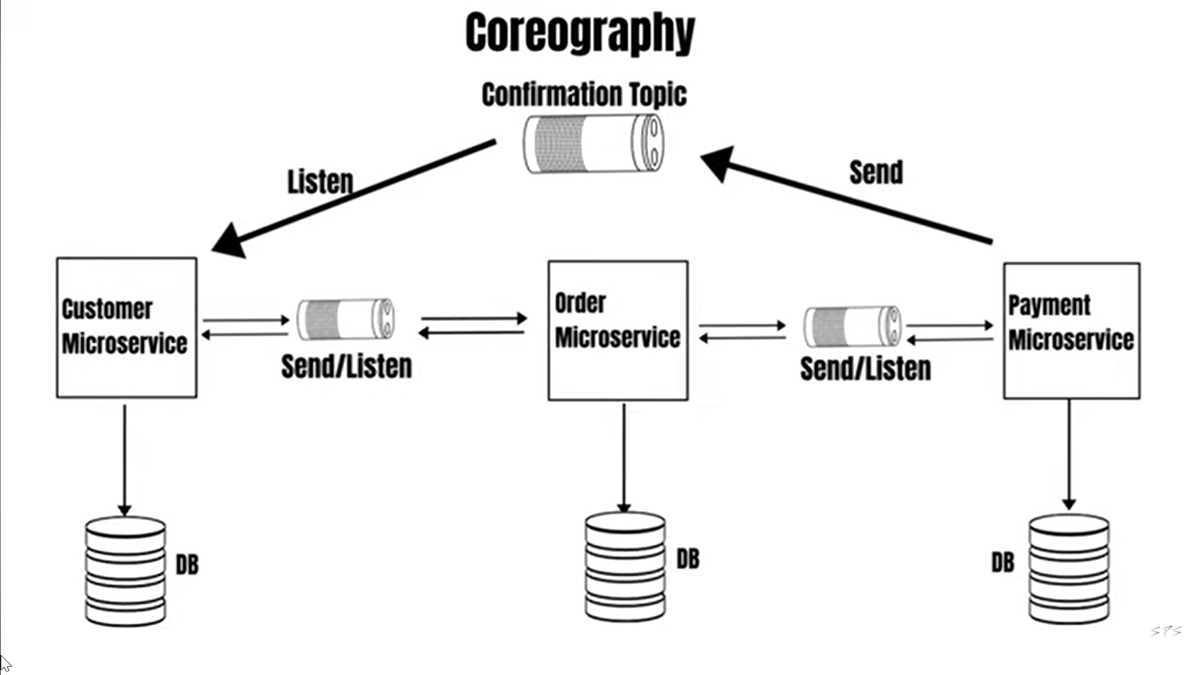

Slide 7
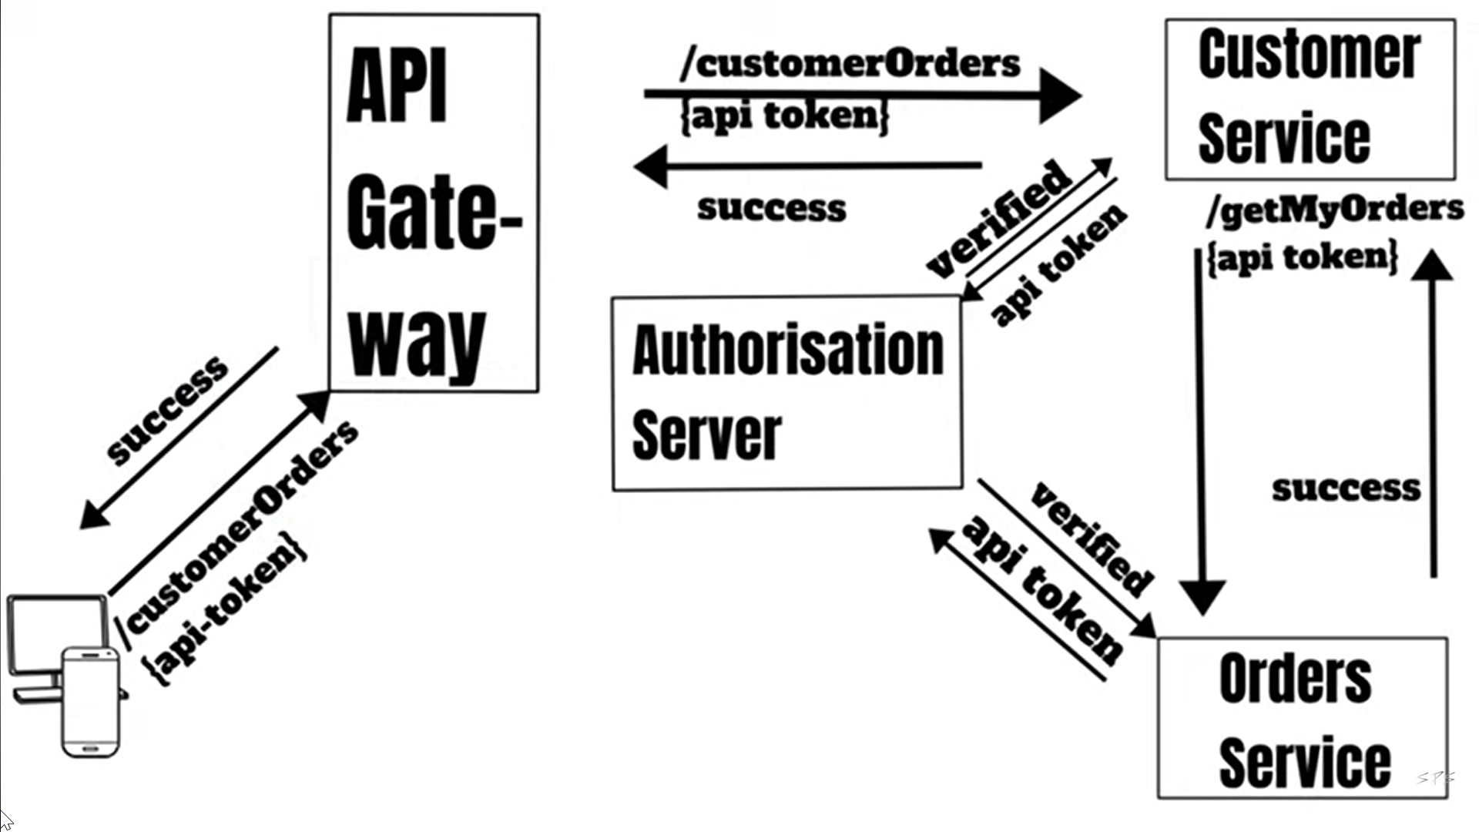

Slide 8
Deign pattern & Principles
Database per Service Pattern
Gateway Routing Pattern
Gateway Aggregation Pattern
Gateway Offloading Pattern
Circuit Breaker Pattern(Closed, Open, Half Open)
SAGA Pattern (Choreography , Orchestration)
Mediator & CQRS Design Pattern
API Gateway Pattern
Backends for Frontends Pattern
Service Aggregator Pattern
Service Registry Pattern
Event Sourcing Pattern
Materialized View Pattern

Slide 9
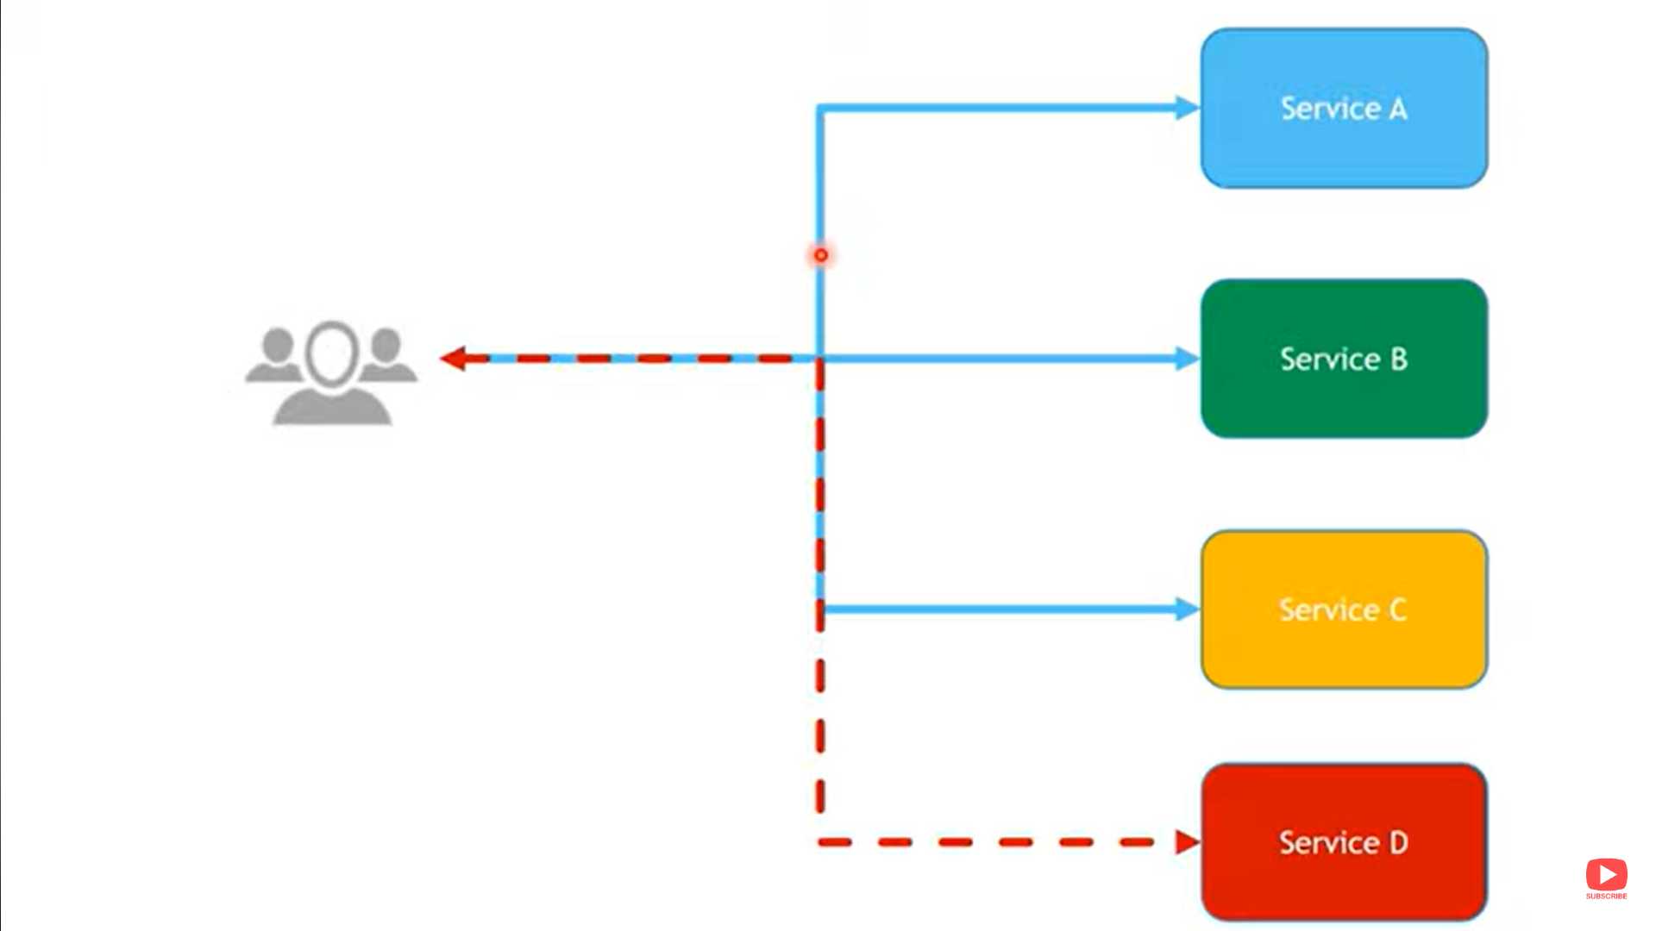
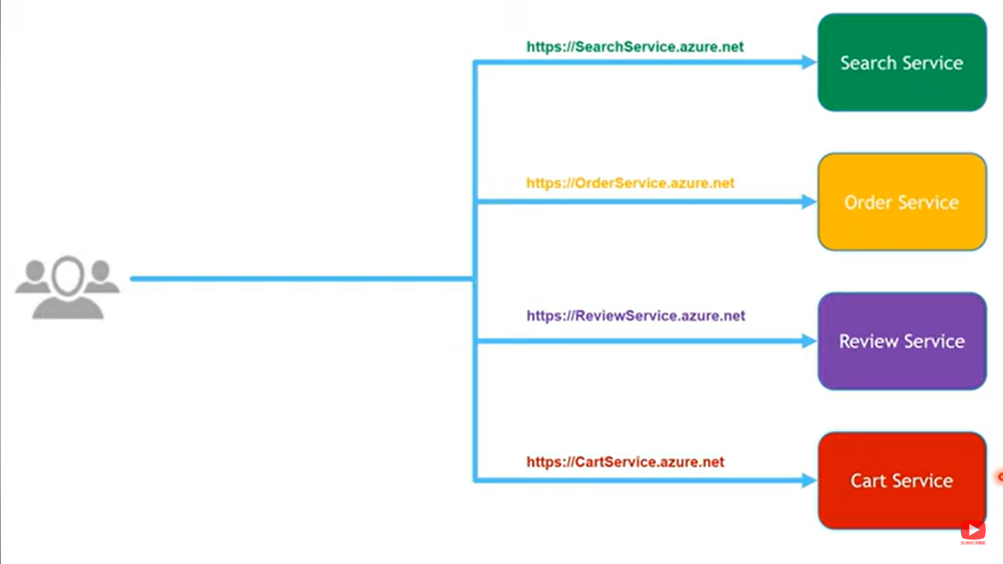
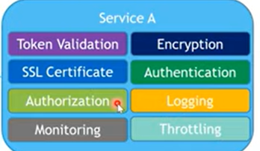
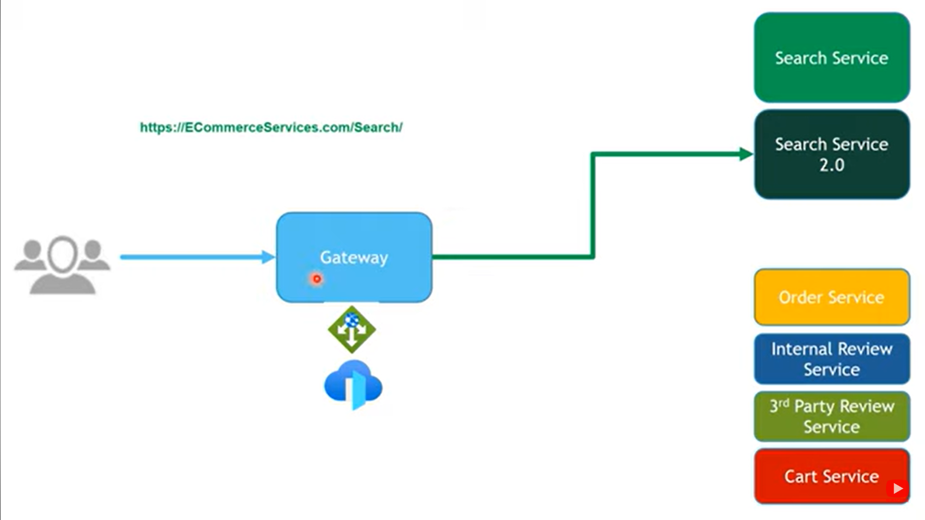
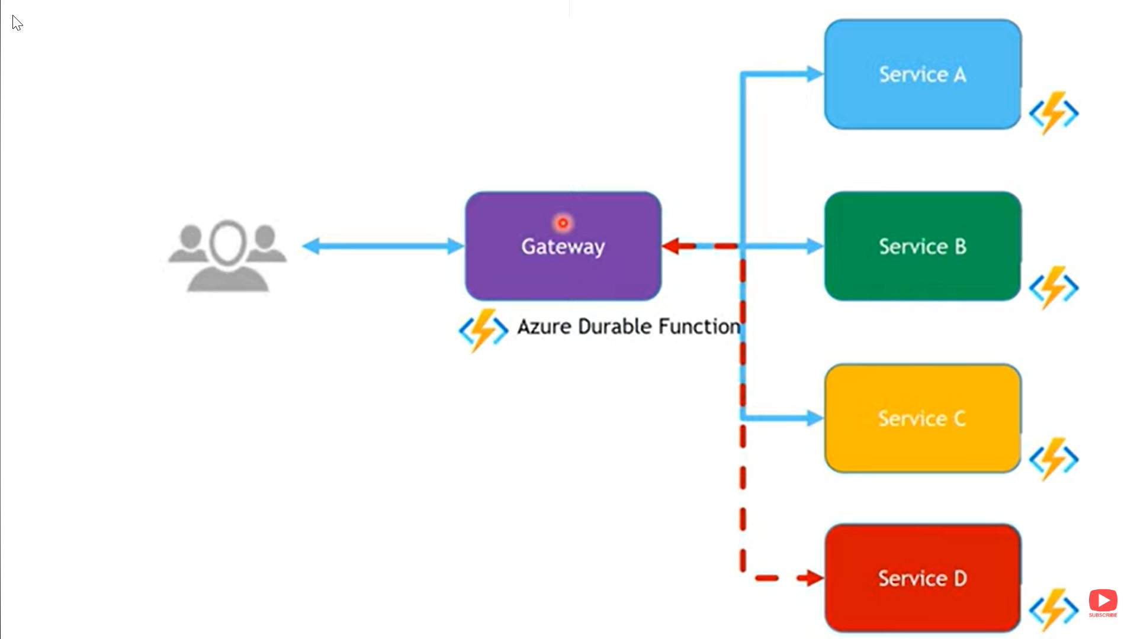
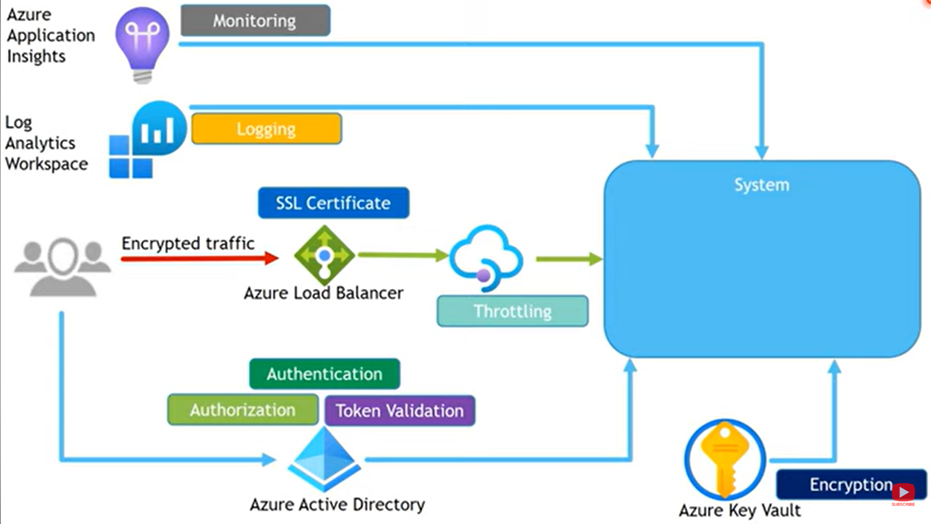
Gateway Aggregator Pattern
Gateway offloading
Gateway Routing Pattern (Define Routing Rules)

Slide 10
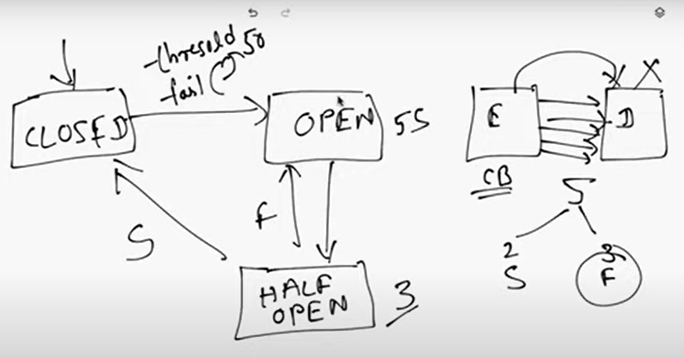
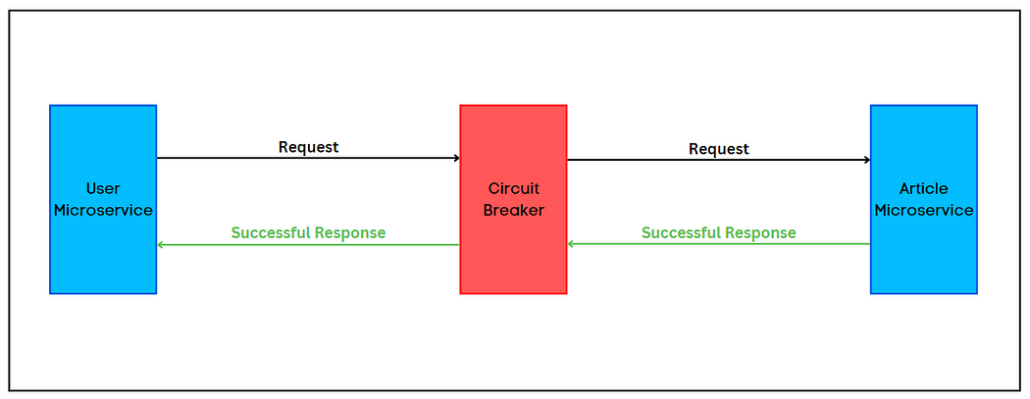
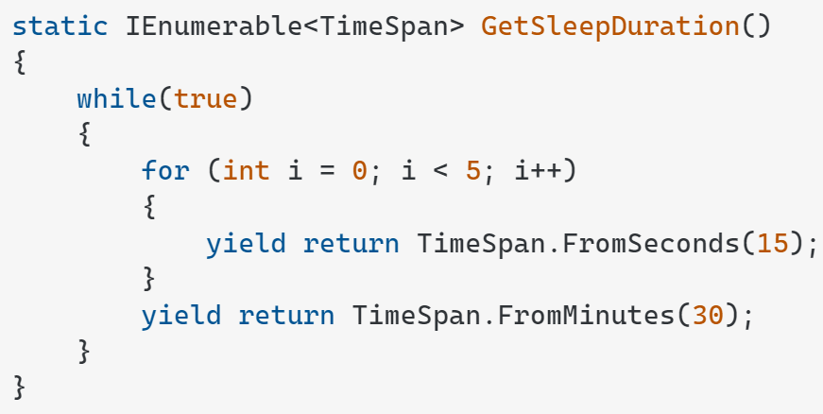
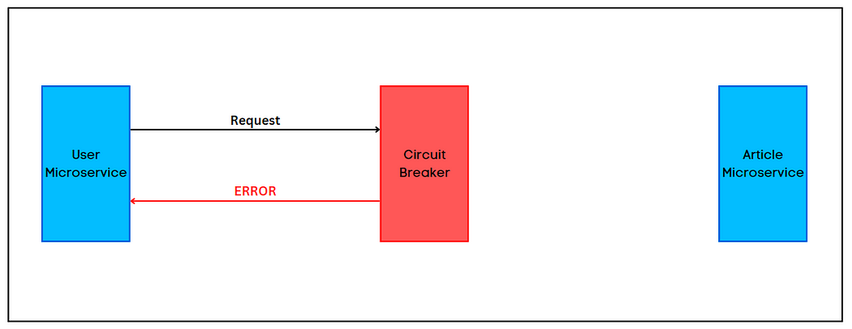
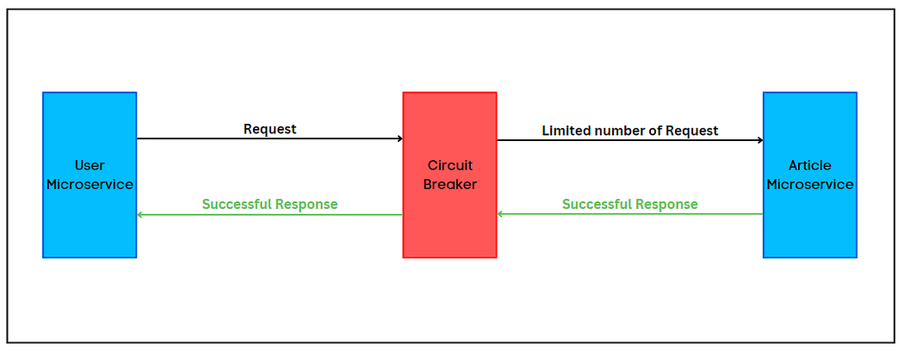
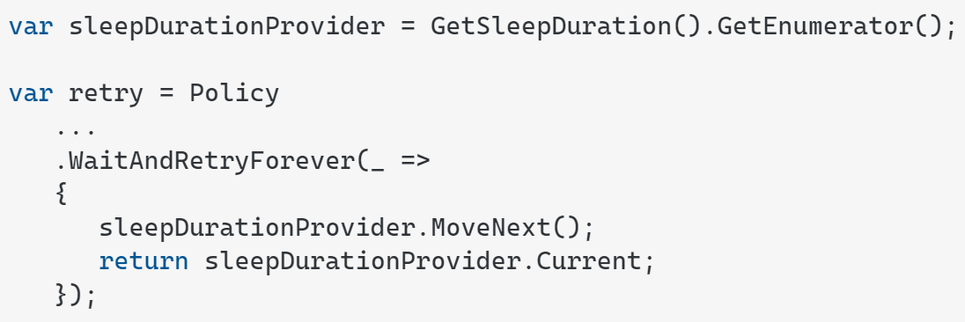
Closed,Open
Half Open

Slide 11
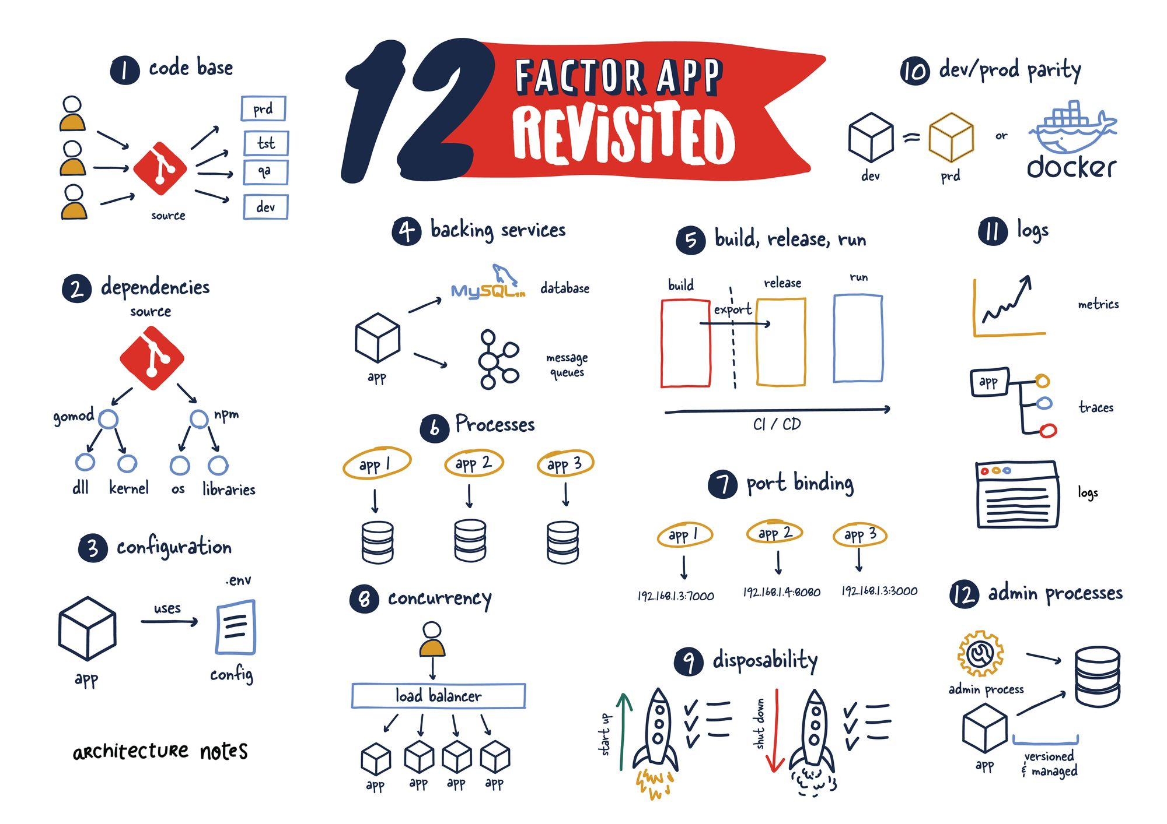

Slide 12
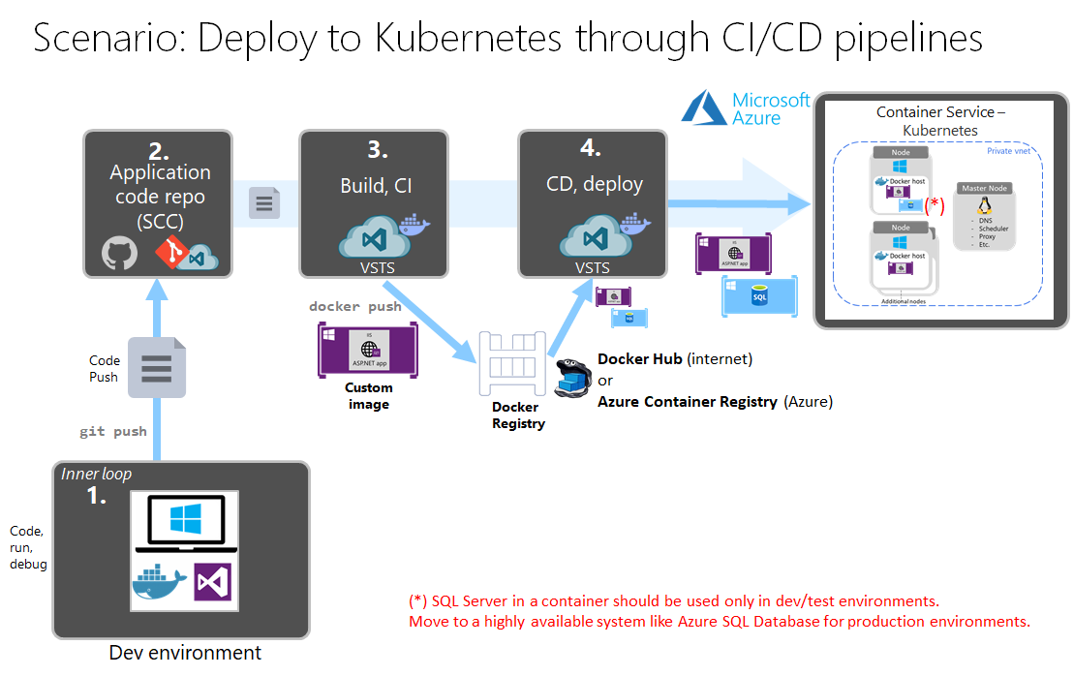

Slide 13
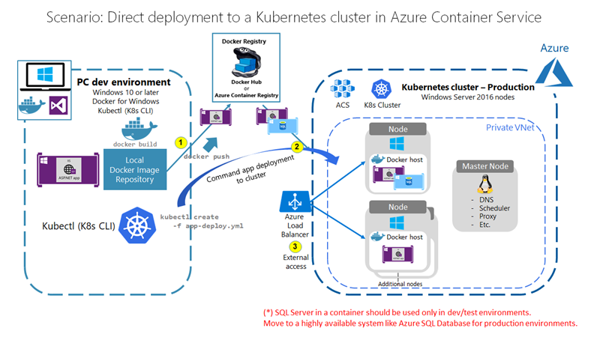

Slide 15
A user makes a request to the application endpoint from the internet.
Azure Application Gateway receives traffic as HTTPS and presents a PFX certificate previously loaded from Azure Key Vault to the user.
Application Gateway uses private keys to decrypt traffic (SSL offload), performs web application firewall inspections, and re-encrypts traffic by using public keys (end-to-end encryption).
Application Gateway applies rules and backend settings based on the backend pool and sends traffic to the API Management backend pool over HTTPS.
API Management is deployed in internal virtual network mode (Developer or Premium tier only) with a private IP address. It receives traffic as HTTPS with custom domain PFX certificates.
Azure Active Directory (Azure AD) provides authentication and applies API Management policies via OAuth and client certificate validation. To receive and verify client certificates over HTTP/2 in API Management, you need to enable Negotiate client certificate on the Custom domains blade in API Management.
API Management sends traffic via HTTPS to an ingress controller for an AKS private cluster.
The AKS ingress controller receives the HTTPS traffic and verifies the PEM server certificate and private key. Most enterprise-level ingress controllers support mTLS. Examples include NGINX and AGIC.
The ingress controller processes TLS secrets (Kubernetes Secrets) by using cert.pem and key.pem. The ingress controller decrypts traffic by using a private key (offloaded). For enhanced-security secret management that's based on requirements, CSI driver integration with AKS is available.
The ingress controller re-encrypts traffic by using private keys and sends traffic over HTTPS to AKS pods. Depending on your requirements, you can configure AKS ingress as HTTPS backend or passthrough.

Slide 16
Azure Application Gateway
Azure API Management
Azure Key Vault
Azure Kubernetes Services
Azure CosmosDB
Azure SqlDatabase
Azure app Serivces
Azure Active Directory
Azure Container Registory
Azure Private End Points
Flow: Git, Docker, Kubernetes

Slide 17
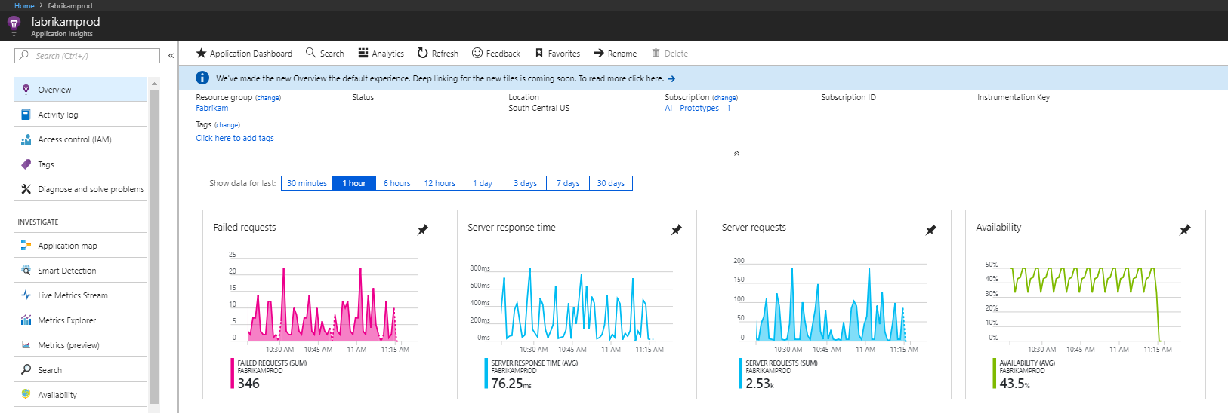
Azure application insight
Application Insights is an extension of Azure Monitor and provides application performance monitoring (APM) features. APM tools are useful to monitor applications from development, through test, and into production in the following ways: Proactively understand how an application is performing.

Slide 18
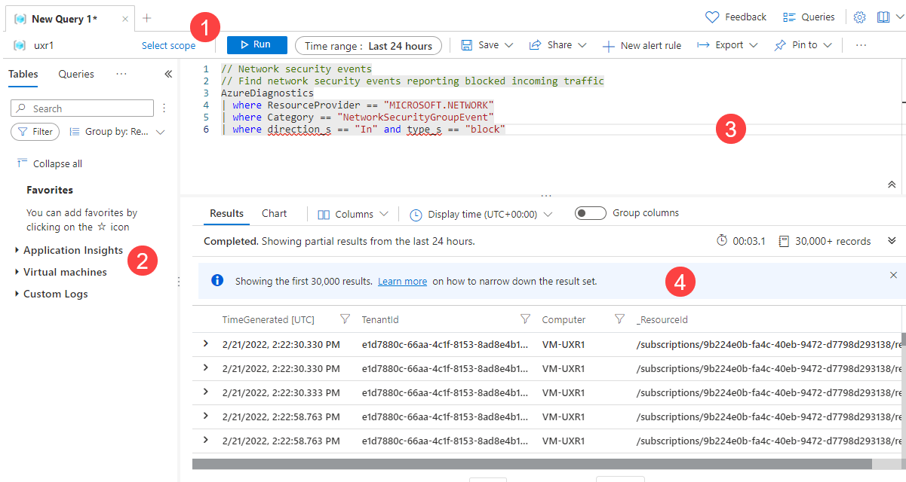
Azure Log Analytics

Slide 19
Azure Bastion
Microsoft Sentinel – (SEIM Security Event and Incident Management
, SOAR -Security Orchestration, Automation and Response)
Microsoft Defender for cloud
Azure Monitor
Application Insight
Log Analytics
Private EndPoints
Azure DevOps Build & Release CICD Pipeline

Slide 20


Slide 21
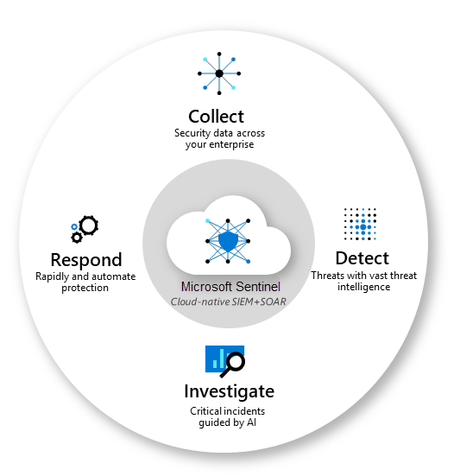
Azure Sentinel

Slide 22
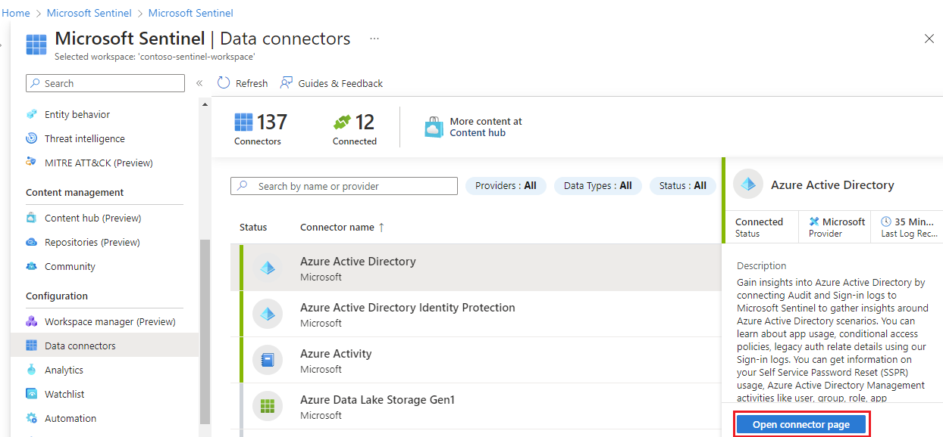

Slide 23
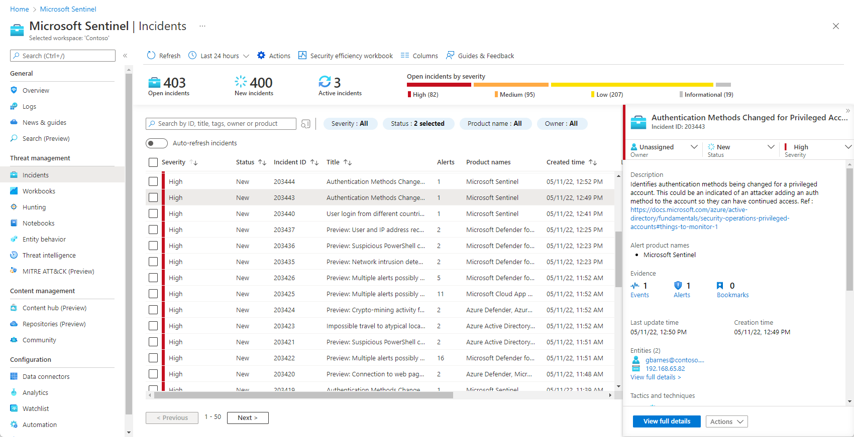
Notes:
https://learn.microsoft.com/en-us/azure/sentinel/overview

Slide 24
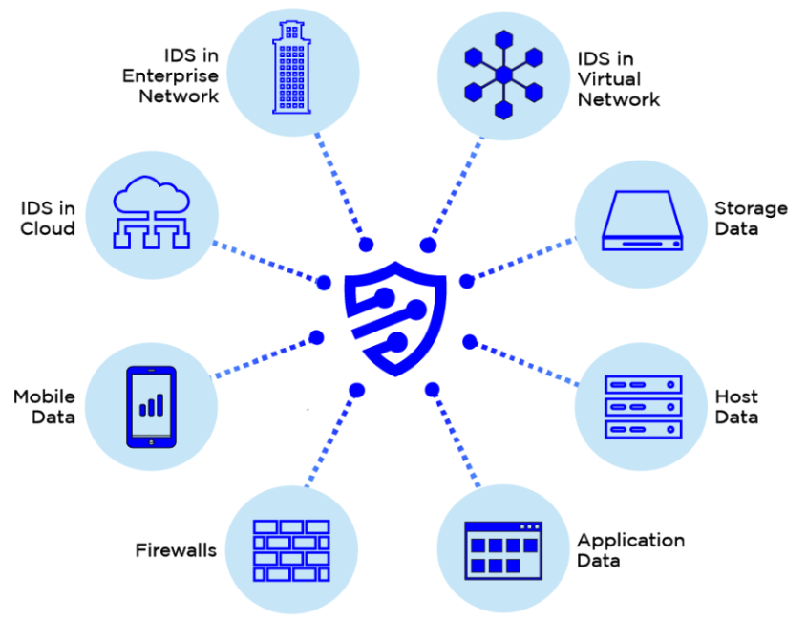
Azure Sentinel: Security Event and Incident Management (SEIM)
Refers to cyber security products and services that provide real time analysis, monitoring, and alerting on security logs and generated by applications, hosts, and network devices. SEIM solutions do this by collecting these disparate logs, normalizing the data, and running the logs entries through complicated algorithms that tease out interesting patterns of behaviors that require human research and confirmation. SEIM solutions are purchased as software, appliance, or managed services solutions.

Slide 25
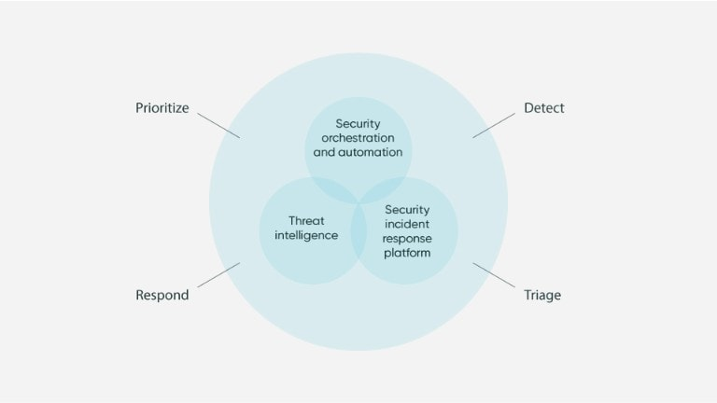
Azure Sentinel: Security orchestration, automation, and response (SOAR)
Security orchestration, automation, and response (SOAR) primarily focuses on threat management, security operations automation, and security incident responses. SOAR platforms can instantly assess, detect, intervene, or search through incidents and processes without the consistent need for human interaction.

Slide 26
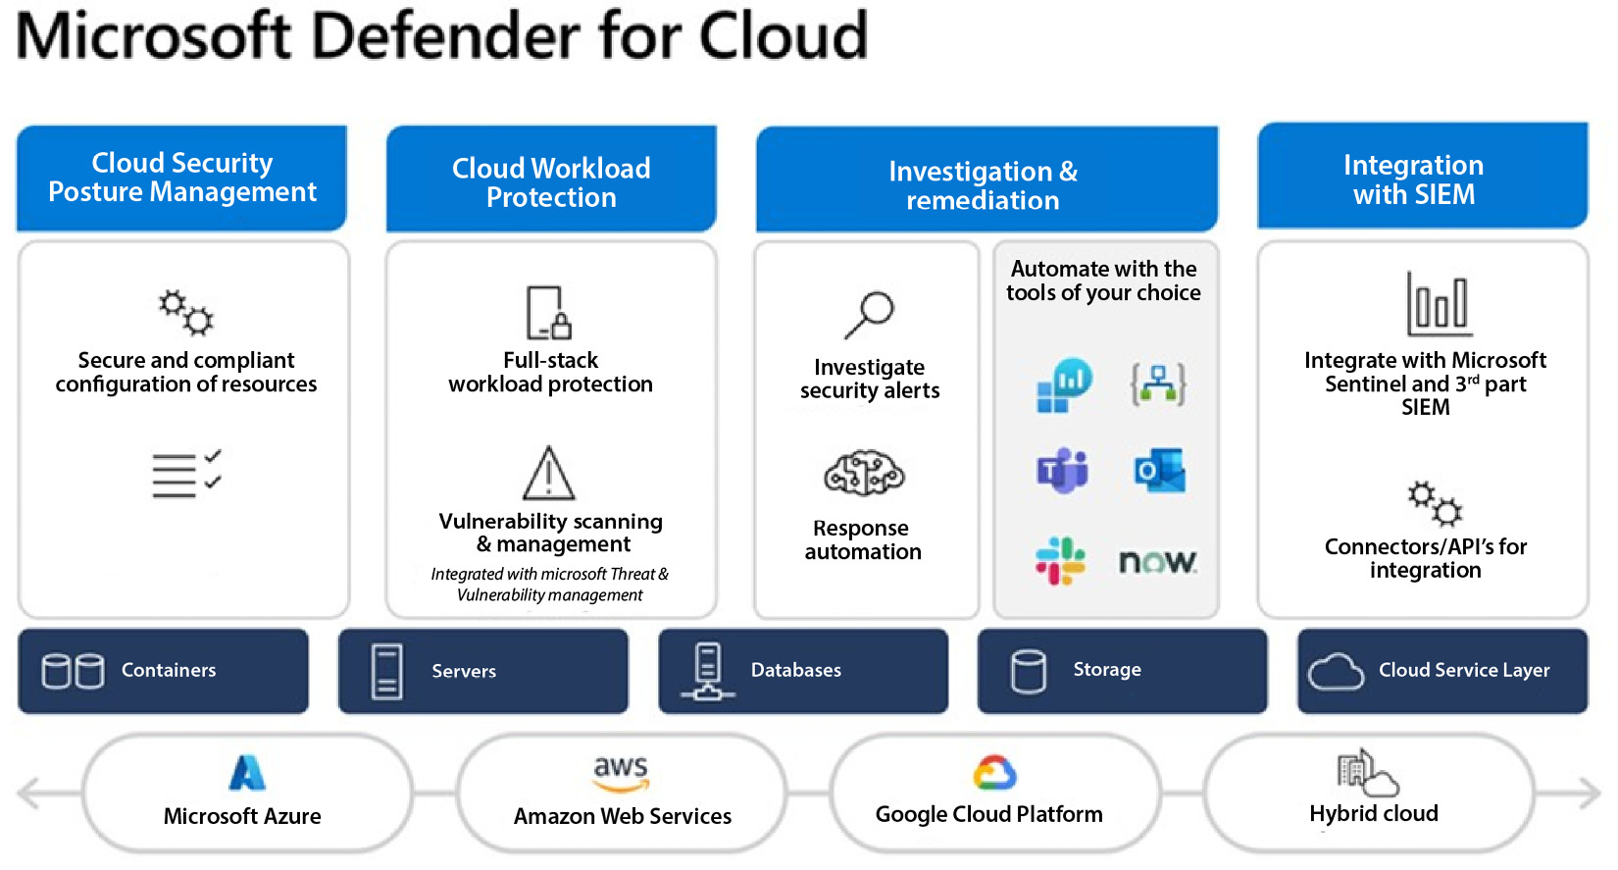

Slide 27
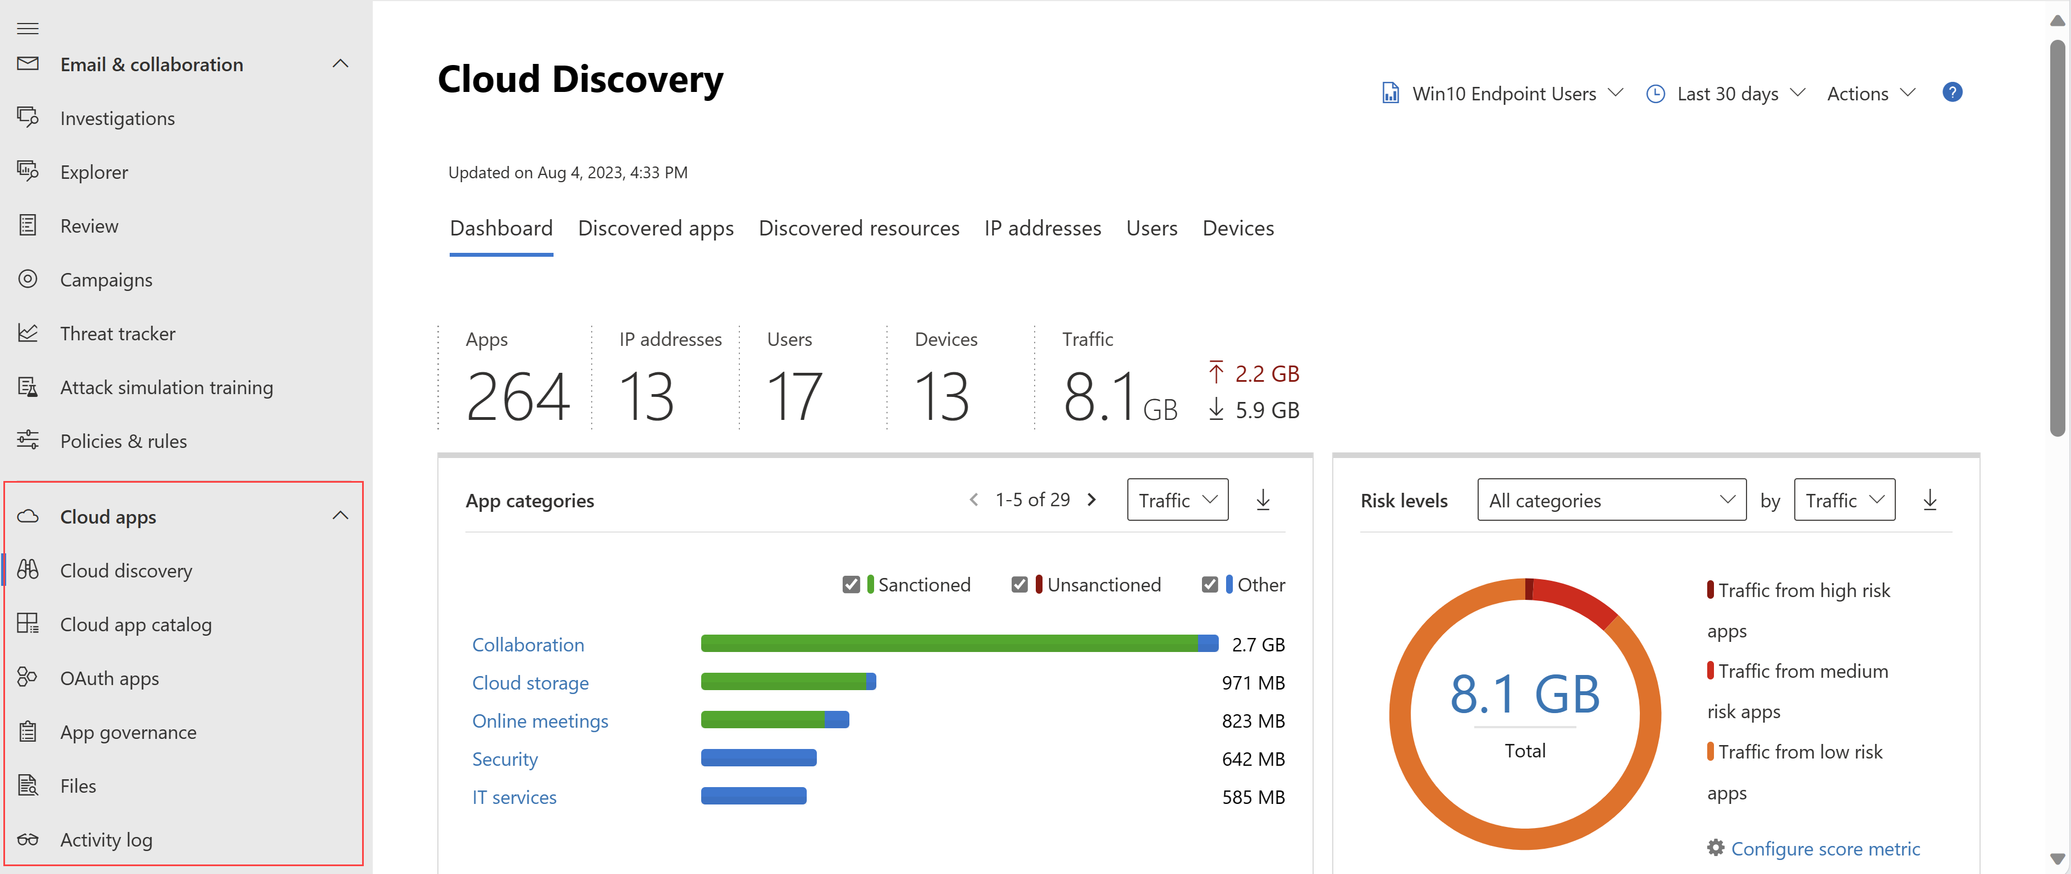

Slide 28
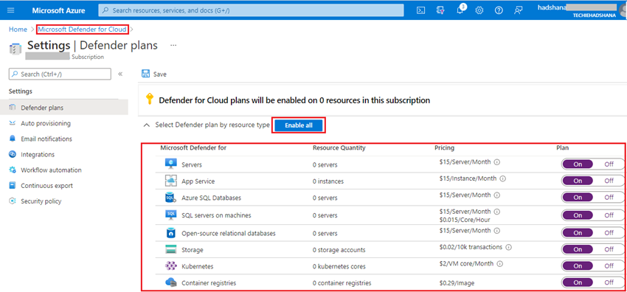
Notes:
https://www.c-sharpcorner.com/article/how-to-enable-microsoft-defender-for-all-the-azure-subscriptions-on-cloud/

Slide 29
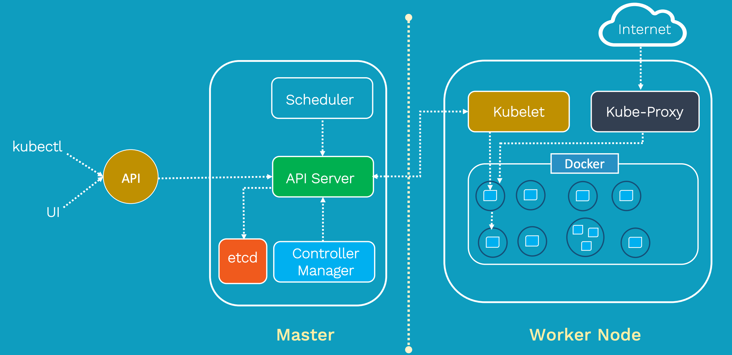
Kubernetes, also known as K8s, is an open-source system for automating deployment, scaling, and management of containerized applications.
Master Node
API Server
Control Manager
Scheduler
etcd
Worker Node
Kubelet
Kube- Proxy
Container Runtime engine
(Docker)

Slide 30
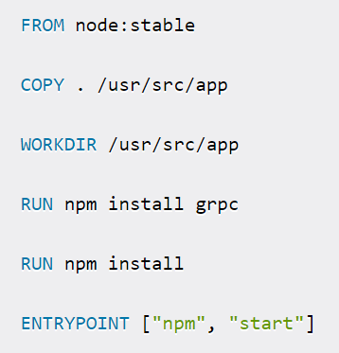

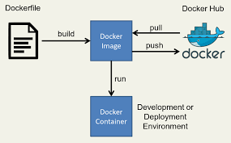
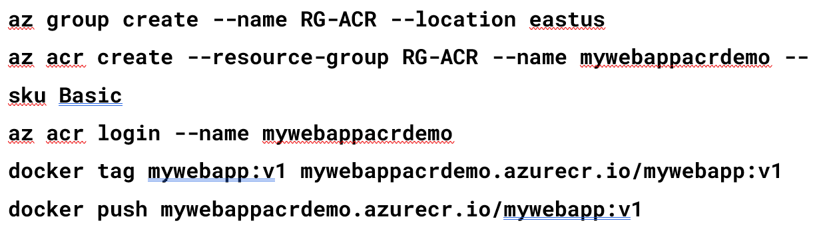
Docker
Docker Build -t,
Docker run
Docker Tag
Docker Push

Slide 31
